Slide 1

How to care for your Jackson Pratt (JP) Drain
Breast Surgery Enhanced Recovery
2/6/2023

Slide 2

What is a Jackson Pratt (JP) Drain
After surgery body fluid may collect under or near the surgery site.
A drain is placed to help these fluids exit your body.
Draining the fluid helps in healing and preventing infection.

Slide 3
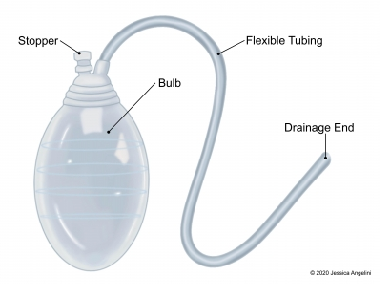

How the JP drain works
The JP drain is a suction device with a tube that sits under your skin.
One or two stiches hold it in place.
At the end, there is a squeeze bulb. This collects the fluid after passing through the tube.
The bulb has a plug so you can empty the fluids and push the air out.
Removing the air by squeezing the bulb causes a suctioning effect which draws the fluids out the surgical site.
Notes:
Delete rubber

Slide 4
How to care for your JP drain
Always wash your hands before you care for your drain
Keep the bulb attached to your clothes or a lanyard with a safety pin so it doesn’t pull on the stiches
Your drain should be emptied four (4) times a day, or when the bulb is half full
Inspect the site for signs of infection
  A little redness at the site is normal

Slide 5
How to Empty your JP drain
Wash your hands
Gather your supplies – alcohol wipe, measuring cup
Start by “milking” the tubing
  You may see clotted, pink white or red material in the drain, this is ok
  Use one hand to pinch the tube close to your skin
  Use the other thumb and first finger, slowly slide down the tubing towards the bulb
  This will push any material or clots into the bulb

Slide 6

How to Empty your JP drain
Carefully open the stopper on the bulb and empty contents into the measuring device
Record the amount on your worksheet
Clean the plug with alcohol wipe
Squeeze the bulb and replace the stopper to create a new suction
Discard the fluid in the toilet and wash your hands

Slide 7

When to call the doctor?
Signs of infection
  Increased pain, swelling, warmth, or redness around the area
  Red streaks leading away from area
  Pus draining from the area
  You have a fever
You see a sudden change in color or smell of the drainage
The tube is coming loose where it leaves your skin
You see a lot of fluid around the drain
You cannot remove a clot from the tube by milking the tube

Slide 8
How to care for your JP drain
Call your surgeon’s office to schedule an appointment to have the drain removed when output is 25 mL/day for two (2) days in a row and is mostly clear
IHA Breast Surgery Office 734-712-1700
IHA Plastic and Reconstructive Surgery 810-494-6830

